Slide 1
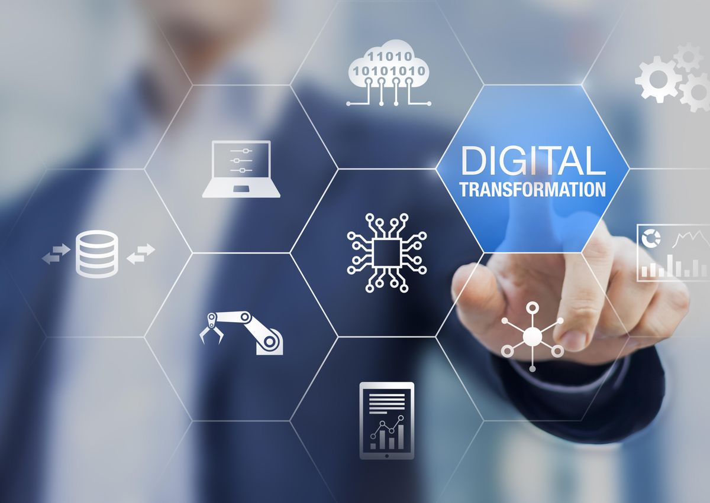
Lecture Series
ICT Evolution and Adoption
Ashish Pachory

Slide 2
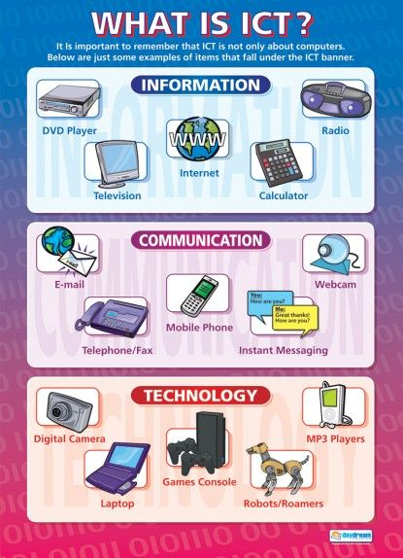
What is ICT?
ICT refers to a CONVERGENCE of INFORMATION and COMMUNICATION technologies
ICT allows people, organizations, and systems to store, convert, process, transmit, retrieve, and protect information anywhere, anytime
While IT, or Information Technology, was the driver of the Information Age, advances in ICT are driving the DIGITAL AGE

Slide 3
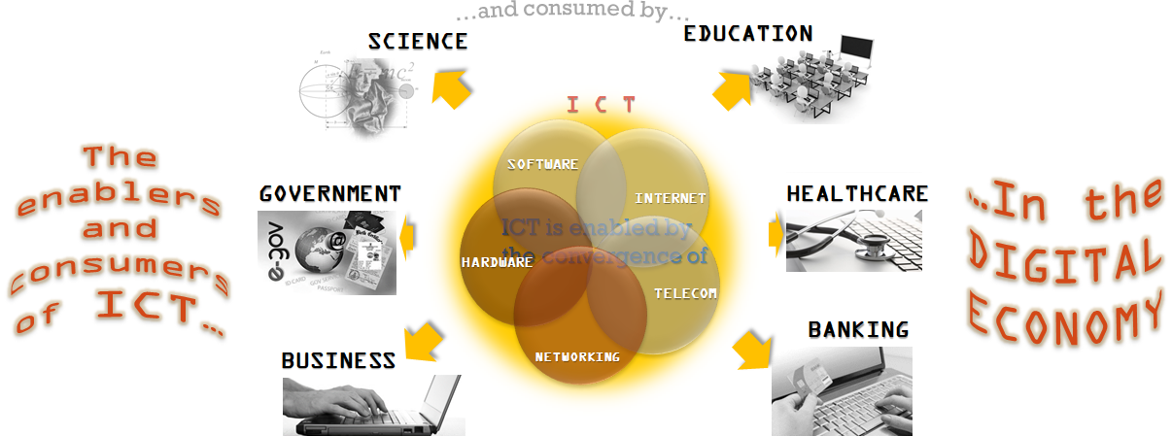
ICT: The Convergence that spawned a New World Order …
Convergence: Merging of existing media to give rise to new or more enhanced media (Laptop, Smartphone, IP-TV, VoIP….)
ICT: Covers products and services that can Store, retrieve, manipulate, transmit or receive information in digitized form.
© Ashish Pachory

Slide 4
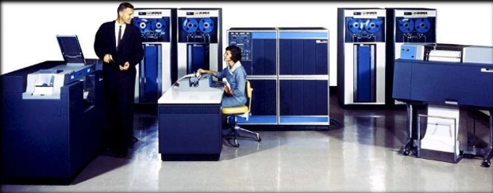
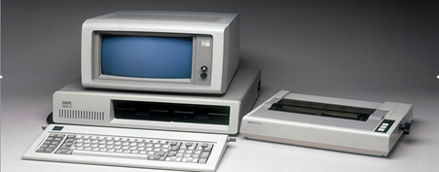
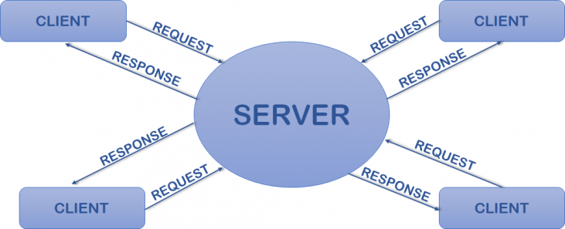
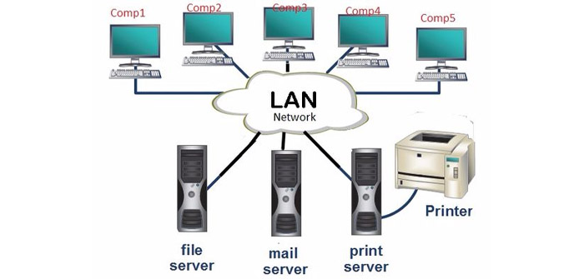
Some Key Milestones in ICT Evolution….
Mainframes and Minicomputers
The IBM-PC and MS-DOS
Client-Server Architecture
Networking and LAN

Slide 5
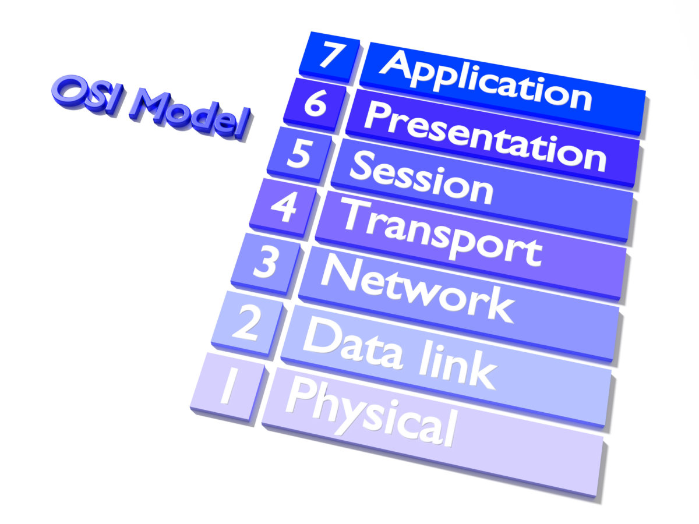
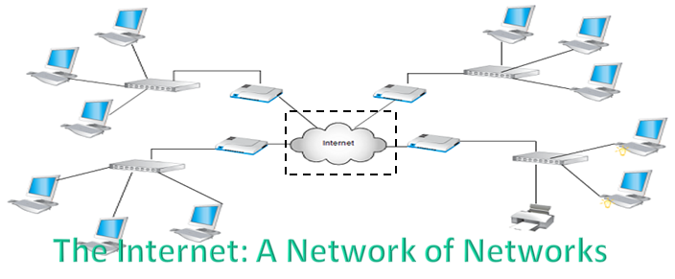
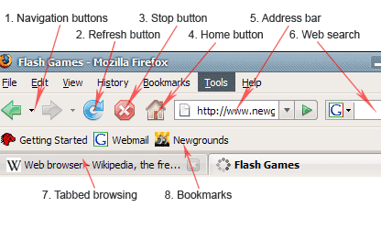

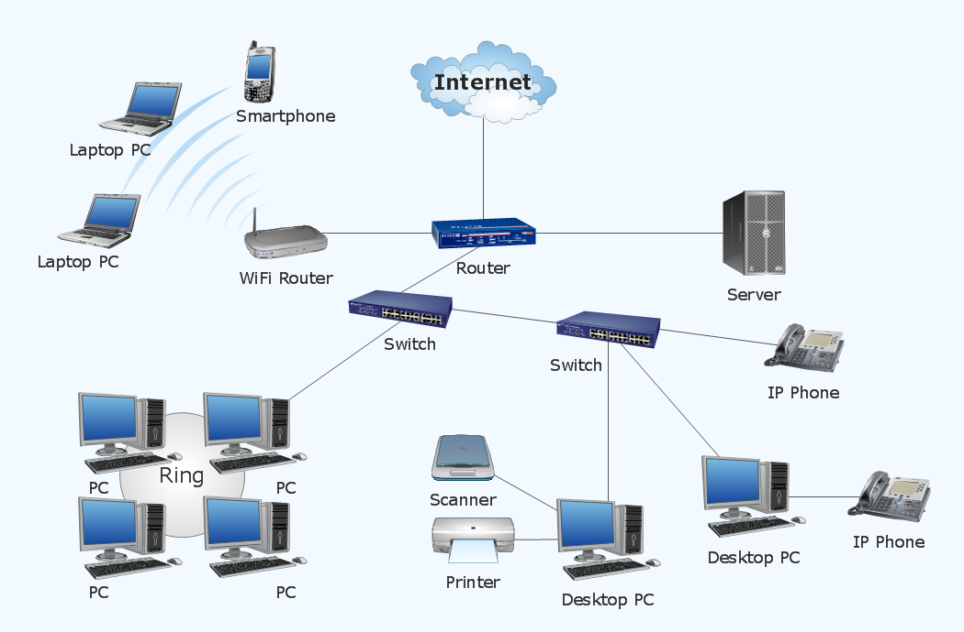
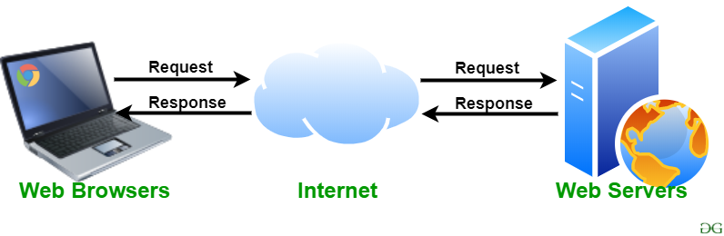
Some Key Milestones in ICT Evolution…(CONTD)
The Internet
World Wide Web and Web Browser
Data Network (Multiple Access Types)
Web Server

Slide 6

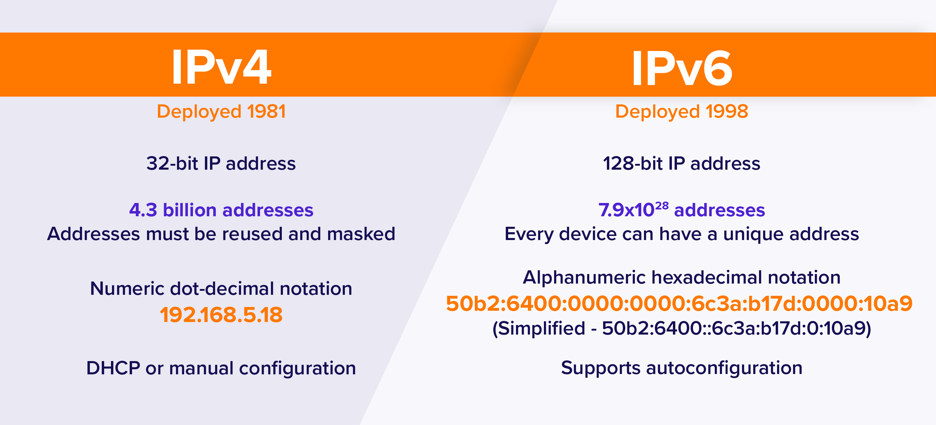
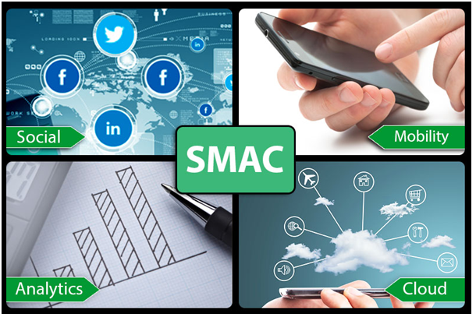
Some Key Milestones in ICT Evolution…(CONTD)
Web Applications
IPv6
Digital Technology

Slide 7
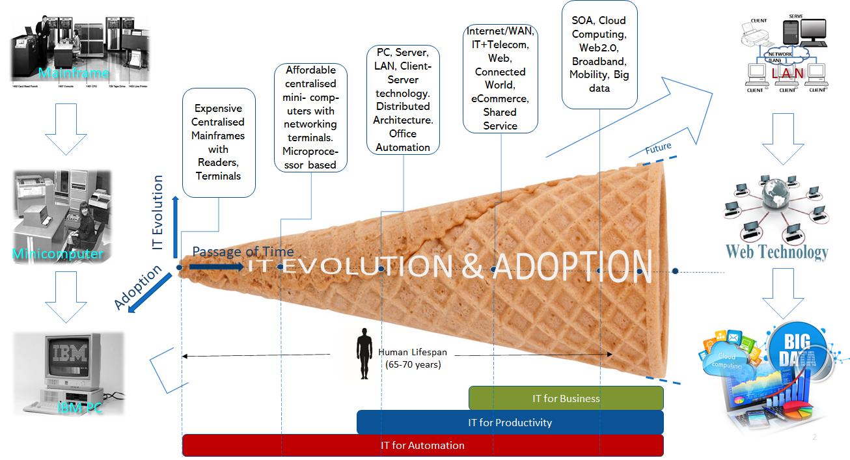
Different Generations of ICT
MILESTONES
Mainframes and Minicomputers: Proprietary tech, Limited display, storage
IBM PC: File Sharing, End-user, MSDOS
Client Server Architecture
Networking and LAN
Packet Transfer (TCP/IP)
Internet
WWW, web Browser
Data Networks
Web Servers
Web Software/Apps
IPv6, Web 2.0
Digital Age
© Ashish Pachory

Slide 8
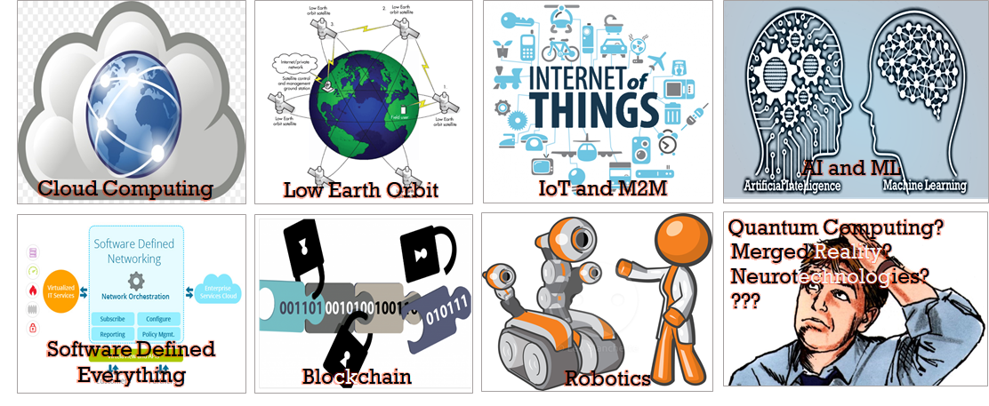
Advances in ICT are Rewriting the Internet Story …
© Ashish Pachory

Slide 9
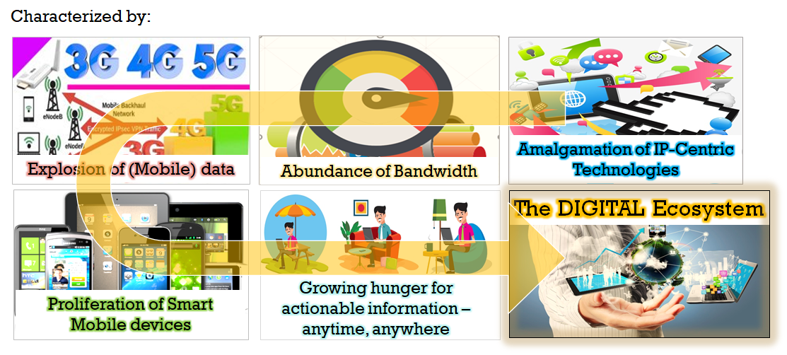
… And Creating a New Environment
© Ashish Pachory

Slide 10
Self-Assessment
What were the main factors behind the adoption of Personal Computers, or PCs?
What is the biggest driver of change in the evolution and adoption of ICT?
What is the common theme that has driven successive generations of ICT so far?
What are the 5 main enablers of ICT and how have they individually impacted an industry (pick any industry)?
In your opinion, what will be the enabling agent of the next generation of ICT, and why?
Why has adoption of ICT been a challenge?
Note: You are welcome to share your answers with me at apachory@outlook.com

